Slide 1


6th International Conference on Advances in Higher Education (HEAd´20)
INTERACTIVE METHODS IN SCIENCE CLASSES
Authors:
Izan Catalán Gallach. Departament Disca, Polytechnic University of Valencia, Spain.
Rodolfo Viveros Contreras. Department of Biological Sciences, Universidad Veracruzana of Xalapa, México
Juan Pedro Catalán Catalán. Concha Espina Study Center in Valencia, Spain.
María José Gallach Vela. College Jaime Balmes in Valencia, Spain.

Slide 2

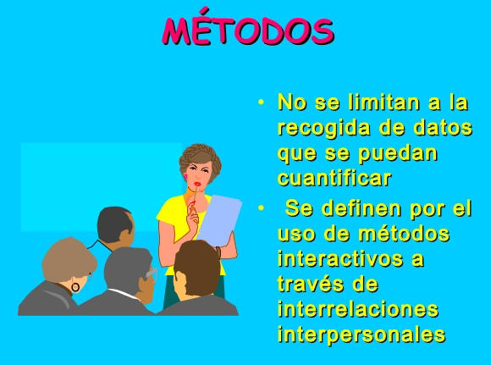
CHARACTERISTICS OF INTERACTIVE METHODS
Interactive methods are identified by "the central element is the student" that becomes the center of the activity.
Two features of these methods:
+ Students have worked as a collaborative team and made decisions.
+ Teachers help and facilitate the learning process and in the construction of knowledge; designs the didactic situation (case, problem, simulation, etc.).

Slide 3
WHY USE INTERACTIVE METHODS?
1) Because the central element in classes with these methods should consist of:
- In promoting and carrying out activities with ICTS technologies
- Using audiovisual media in the classroom for student participation
- Putting a simulation into practice
- Answering questions
- Conduct an investigation or project.
2) Because they present real problems or practical situations to work skills that involve the analysis, thinking and mastery of skills similar to those that a professional in the areas of science must manage.

Slide 4
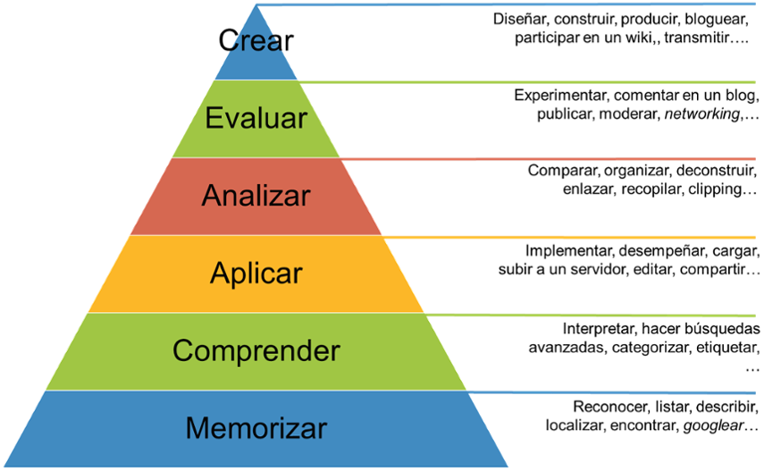
The use of Computer Science and Technologies is the backbone of the various fields or areas of work (especially in the disciplines of science, technology, engineering, mathematics and computer science) to develop the learning skills of the 21st century

Slide 5
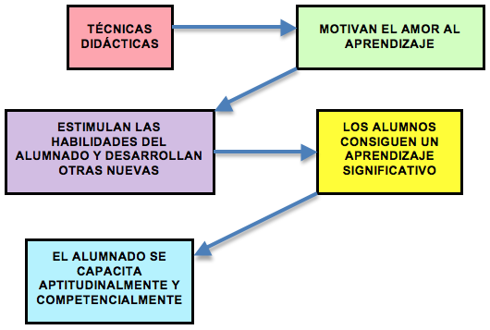
WHAT ARE INTERACTIVE METHODS FOR?
Work critical thinking skills: generate ideas, solve problems, develop hypotheses, verify them, make decisions etc.
Develop interpersonal and teamwork skills.
Develop communication skills such as: searching for information, selecting it, communicating it in writing and orally, interrogating, arguing, using specialized language, etc.
In conclusion: a greater number of educational objectives are achieved.

Slide 6
OBJETIVES OF INTERACTIVE METHODS
Have students build knowledge by studying and working autonomously.
Developing self-learning ability
To publicize trends and development prospects with new methodologies so that teachers and students can be enriched with these experiences.

Slide 7
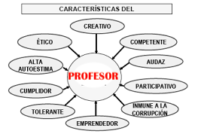
TEACHER ROLES
The main functions of teachers when using these methods in the student teaching-learning process are:
1- Assist students in the learning process and in the construction of knowledge.
2- Design and/or propose the teaching situation (case, problem, simulation, etc.)

Slide 8
And these functions focus on the following aspects:
- Presents the task and help the initial ideas of the students emerge
- Give clear instructions on the task to be performed.
- Encourages you to find various procedures for doing tasks.
- Provides information and resources or ways to achieve them.
- Stimulates the exchange of explanations and information in the realization of a task.
- Provides instruments and valuation criteria to the group regarding the tasks and results obtained.

Slide 9
- Negotiates the working process, the objective and the composition of the group, helps to establish the rules of operation.
- Organizes space and materials based on cooperative work.
- Respond to queries and correct errors.
- Try to ensure the success of the weakest components of the group.
In other words:
Ensure that the basic objectives of learning are achieved and facilitate the learning building process.

Slide 10
STUDENT FUNCTIONS
You need to analyze demand, think, organize, search for information, work as a team, and make decisions.
Students cooperate with each other by giving and receiving help.
Contrast ideas and develop hypotheses and possible solutions and/or alternatives that promote and enrich learning.
Students become the center of activity and teachers help and facilitates the process by facilitating learning

Slide 11
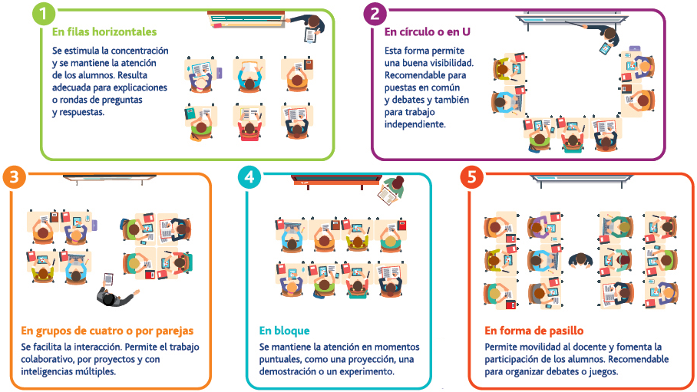

Another conclusion we draw when students use interactive media is that:
When you cooperate and help you don't waste your time, you're learning in a process that improves understanding of each, topic mastery, and communication skills.
The classroom climate is often participatory and dynamic
The organization of space in class is essential to work with various pedagogical methods, so it is necessary to adjust the organization of desks to the learning needs of the students. In our case for Collaborative Learning.

Slide 12
HOW TO USE INTERACTIVE METHODS?
FIRST OF ALL IS THE FORMATION OF THE WORKING GROUPS.
They must meet the following characteristics:
Few students in the group: collaboration to learn and help learn.
Randomly formed, by list order, depending on the proposed task, etc.
Heterogeneity of the group: to achieve learning by interaction and aware of cooperation.
Good work organization: help groups adopt a leadership style to build learning and decide how to work for brainstorming, etc.
Responsibility for functions as a spokesperson, secretary, person responsible for the material, etc. on a rotating basis.

Slide 13
HOW TO USE INTERACTIVE METHODS?
SECONDLY, ARE THE TECHNIQUES TO BE USED IN METHODS.
The various interactive methods have many elements in common and it is not always easy to narrow the difference. Its implementation usually requires:
Use new technologies: propose interaction activities.
Interact in class from assumptions, exercises and verification and performance activities.
Use strategies to process information from oral exposures, written texts, graphic material, iconic or statistical.
Use concept simulation techniques in science.

Slide 14
HOW TO USE INTERACTIVE METHODS?
Develop participatory, descriptive, explanatory and argumentative materials.
Deepening asking for reasons. And answer the questions with other questions.
Use strategies to process information from oral exposures, written texts, graphic material, iconic or statistical.
Interpret data, give examples, make clarifications, summarize,...
Make short presentations to present concepts or techniques.

Slide 15
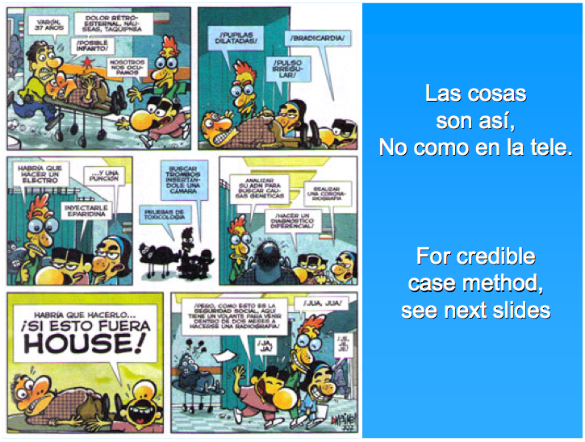
THE CASE METHOD
Things are like that, not like on TV

Slide 16
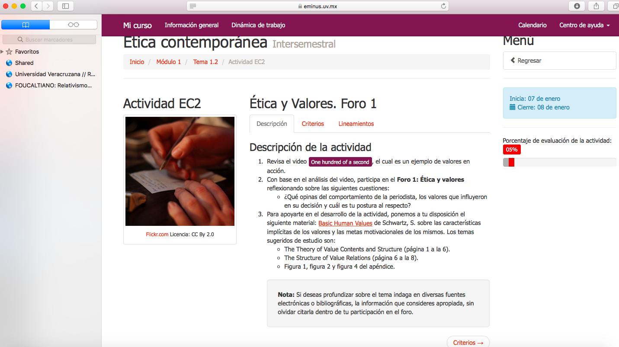
THE CASE METHOD
¿What is it?
It is the description of a specific situation that brings that reality closer to a group of people in training.
An initial analysis of the case is performed in a group, with a working script oriented by the teacher to interpret and clarify.
The problems are defined below, conclusions are reached on actions to be taken, search and analyze information, contrast ideas, defend them with arguments and decision-making.

Slide 17
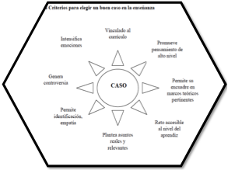
THE CASE METHOD
Features of this method
The situation that arises must be real or appear to be real because it is logical and admissible.
It must be relevant to students, so that they can be involved in their resolution.
It must be unresolved, unresolved, as students must generate hypotheses, contrast, make guesses, complete knowledge and seek solutions and alternatives.
It should not have a unique situation because the discrepancy must have a space.
The decision that is made must be argued.

Slide 18
THE QUESTION CHAIN METHOD
What is it?
It is a suitable method to review any topic worked and prepare the exam.
For about three minutes each team thinks of a question on the topic that will pose to the team next to it, following an order.
Features.
- Questions are asked about fundamental issues (which could be taken on an exam) worked in the class to help other teams. Four-component equipment.
- Starts by giving 3 minutes to all teams to search for a question.
- After three minutes, the spokesperson of one team poses the question to the next team, which answers it, and then the spokesperson of this team asks the question to the next, and so until the last team asks the question to the first team that has started.
- There are two spokespersons per team: one to ask the question and one to give the answer.

Slide 19
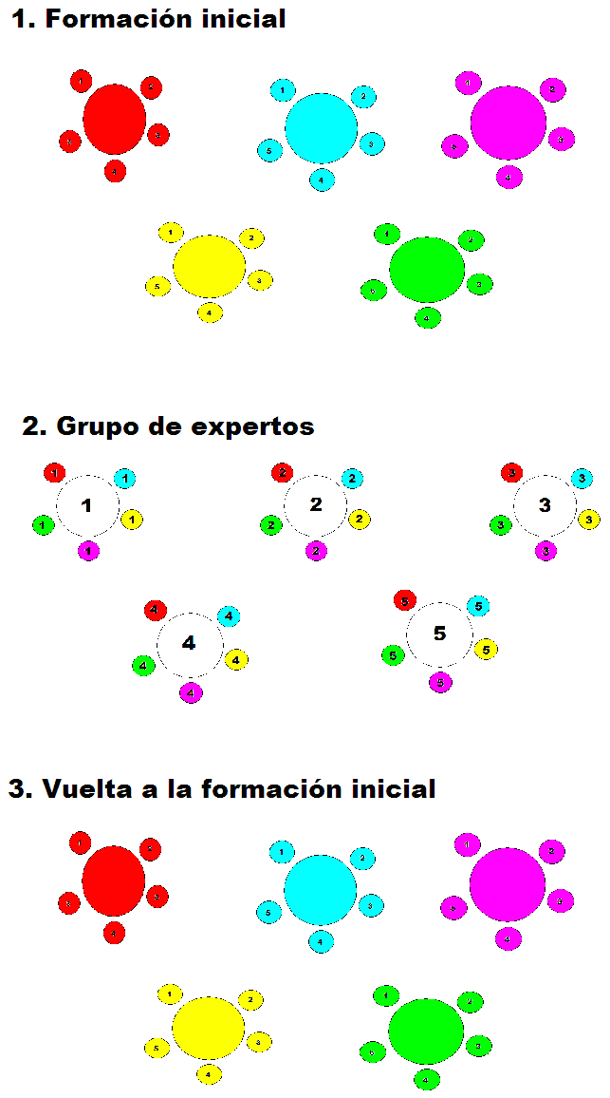
THE PUZZLE METHOD
What is it?
This technique is especially useful for areas of knowledge where content is likely to be "fragmented" in different parts (e.g. experimental, technological,... sciences).
All students are "forced" to cooperate, because each of them has only one piece of work to be done and their teammates have the others, essential to successfully complete the proposed task: the global mastery of a subject under study.

Slide 20
THE PUZZLE METHOD
Features?
The material under study is divided into as many parts as members has the team, each receives a fragment of the information of the topic that all the teams are studying, and does not receive that of other colleagues; you must prepare your own dossier with the information you give him for the teacher or that he has been able to search for.
Then, with the members of the other teams that have studied the same sub-item, form a "group of experts", where they exchange the information, delve into the key concepts, build schematics and conceptual maps, clarify the doubts raised, etc.; we could say that they become experts in their section.
Each of the "these experts" then returns to his home team and is responsible for explaining to the group the part he has prepared.
Then each sub-item is grouped together to form the complete work and expose it

Slide 21
THE PROJECT METHOD
What is it?
It is based on the that learning involves direct contact with the object of study through a planned task, performing activities, using resources and skills that culminate with results in the form of jobs, exhibitions, objects, etc.
Project work puts students at the center of the learning process where brainstorming, creativity and collaboration come into play.
1º | Definition and analysis of the problem
2º | Searching for information
3º | Desing
4º | Planning
5º | Construction
6º | Evaluation
7º | Disclosure

Slide 22
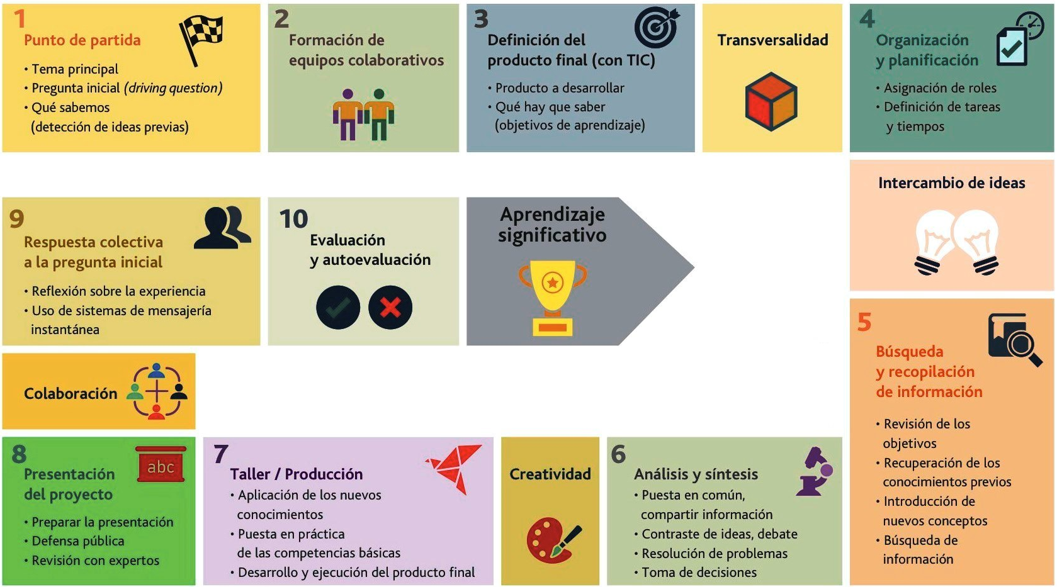
THE PROJECT METHOD
Features?
Work on real problems and involve various disciplines.
The activities to be carried out, the documentation to be delivered, deadlines and evaluation criteria have to be defined.
It requires understanding of the task, planning, searching for various sources of information, teamwork and the realization of the project.
Allows you to globalize content.
Students, they lead the initiative, work autonomously with the help of the teacher who provides them with resources and collaborates with them.

Slide 23
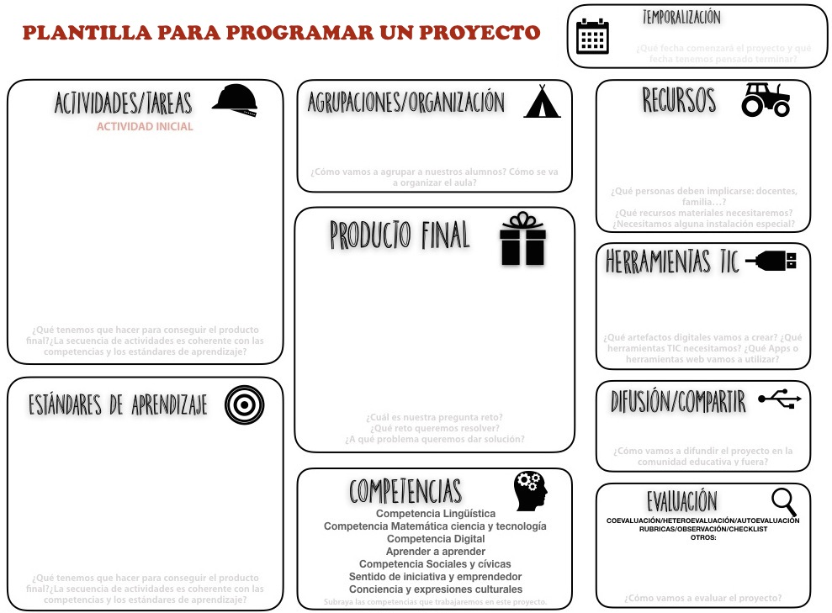
THE PROJECT METHOD
template to schedule a project

Slide 24

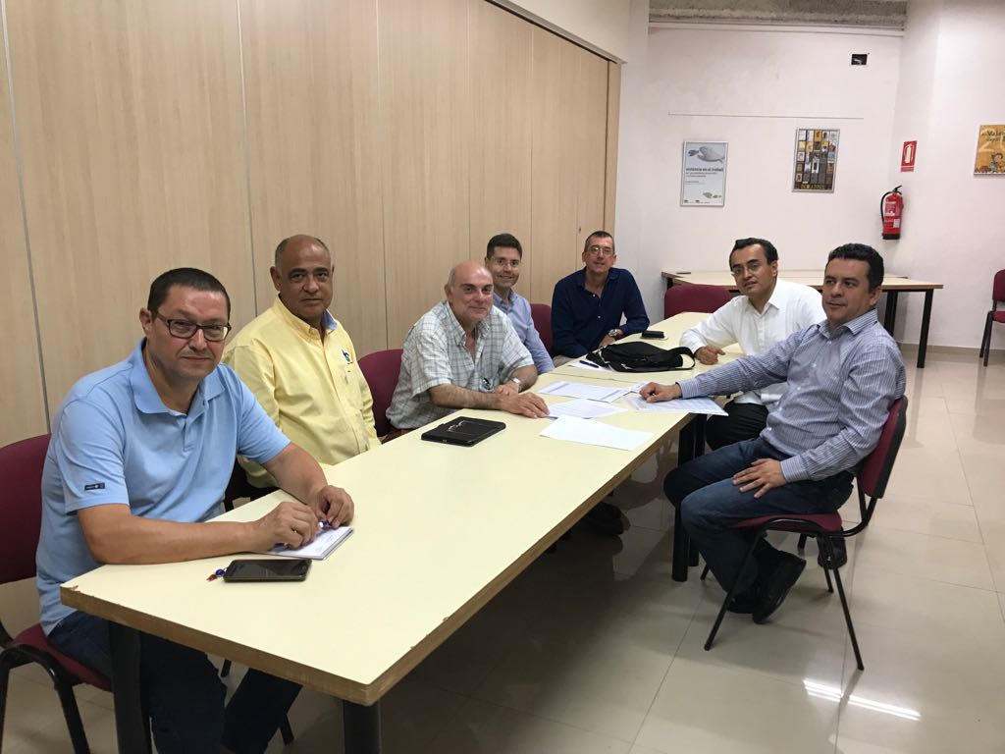
THE PROJECT METHOD
What's the favor?
•Students learn to make their own decisions and act independently.
• Improves motivation to learn because it relies on experience and allows you to apply what you have previously learned to specific situations.
• Strengthens student confidence in themselves and encourages research learning.
Example of collaborative research project on primates, organization:
Team building.
The concretion of the dossier.
Use of tics.
Organization and planning of international group tasks for project production
Preparation of materials.
Project Exhibition.
Meeting with the channel team of the Faculty of Biological and Agricultural Of the University of Veracruzana of Mexico and professors of Valencia

Slide 25
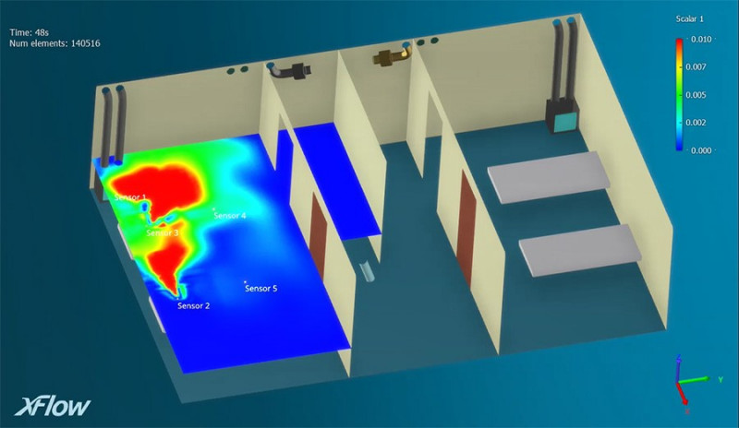
THE SIMULATION METHOD
What is it?
They are a wide range of activities that allow to reproduce or represent in a simplified way a real or hypothetical situation.
They are the most effective means of testing different hypotheses about environmental, computer processes... using models.
It proposes different assumptions and solutions that make it easier to understand the consequences.
Dassault's Simulia Xflow software to anticipate Covid-19 dispersion

Slide 26
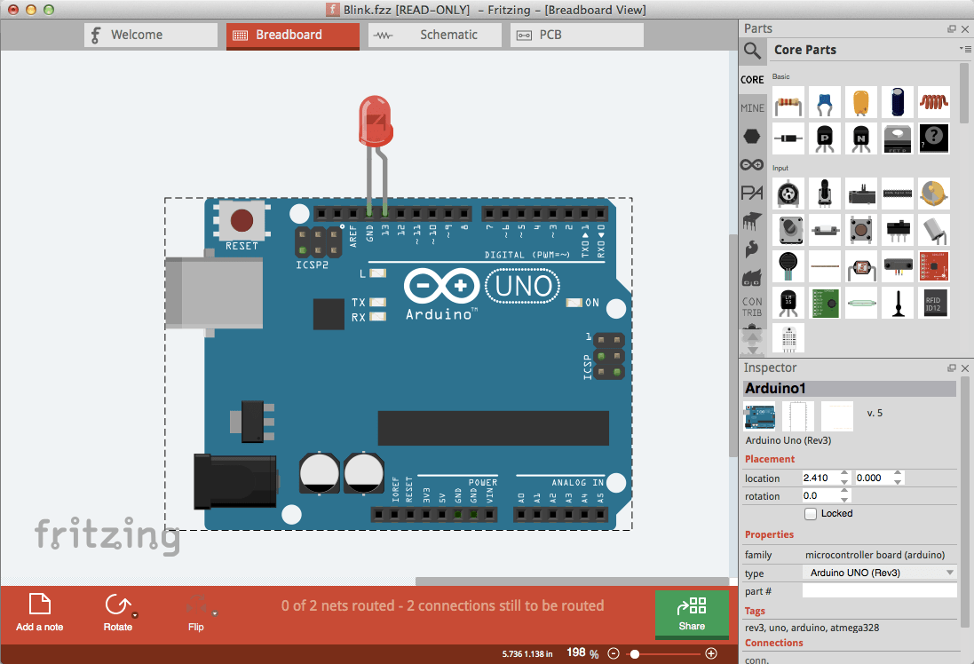
THE SIMULATION METHOD
Features?
Its objective is to make decisions or to understand the interactions of people with the environment around them such as: location of industries, roads, railways, urban planning issues, etc. are very useful in STEMC.
Used: presentation, realization and visualization of the organization of living beings in Biology, Artificial Intelligence in Computer Science... helps students understand the intentions and motivations of social actors.

Slide 27
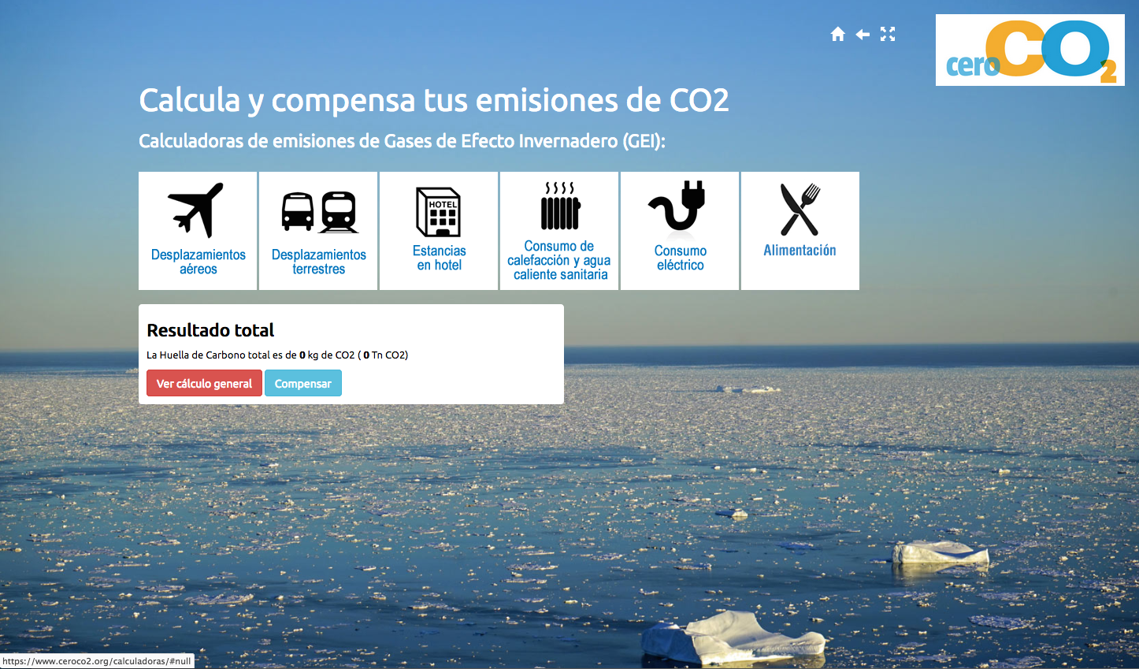
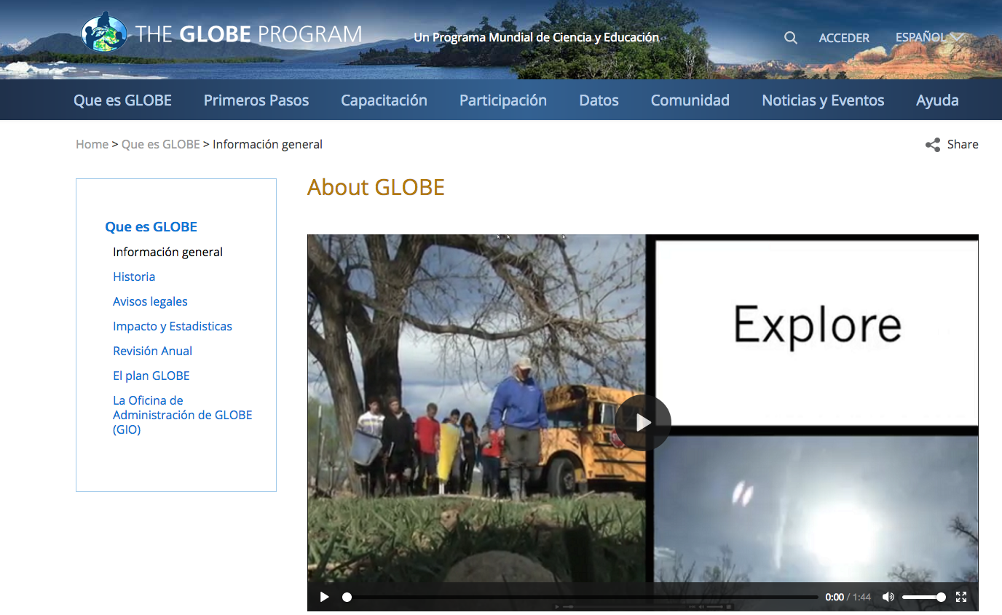
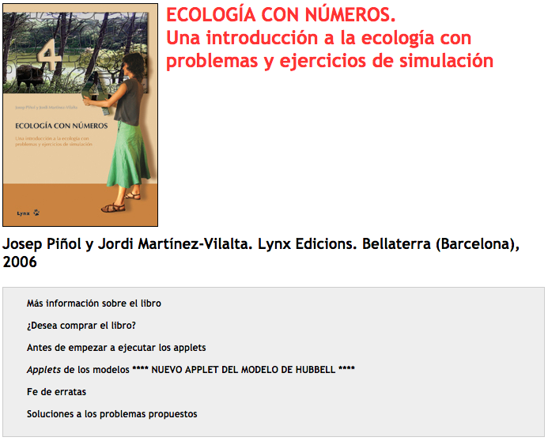
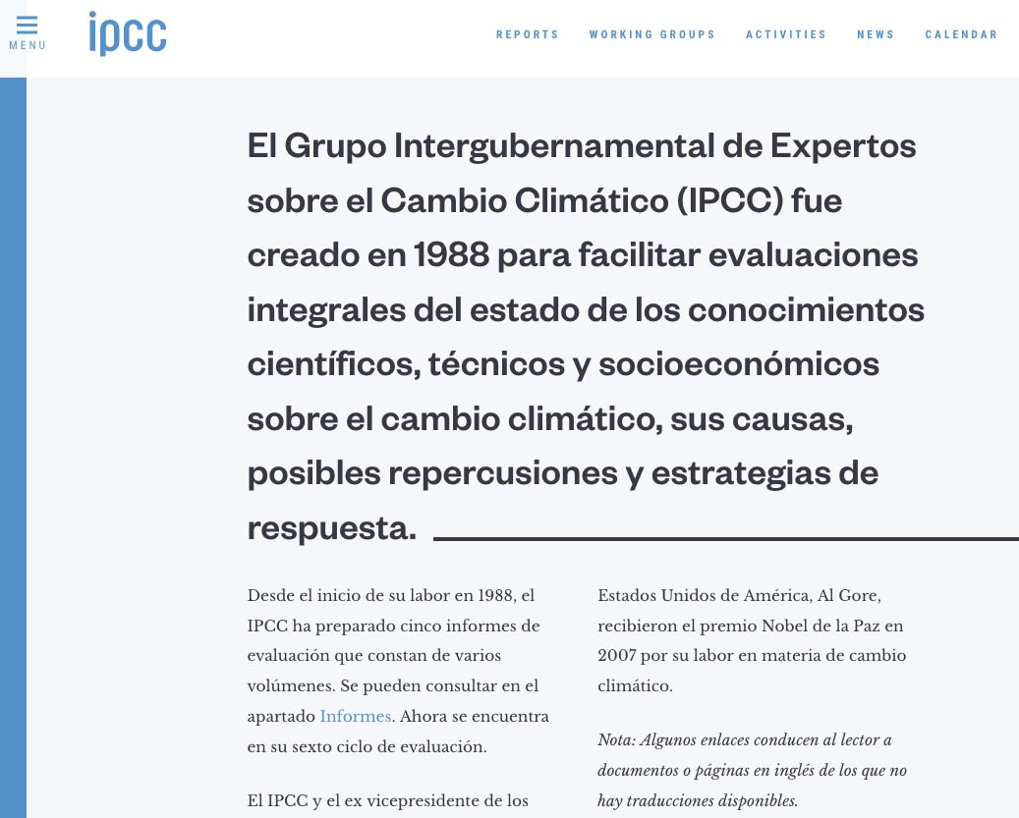
THE SIMULATION METHOD
EXAMPLES OF APPLICATIONS FOR PROCESS SIMULATION
Carbon Footprint Simulation Program www.ceroco2.org/calculadoras/
World Science and Education Programme www.globe.gov/es/
The global reports of the Intergovernmental Panel of Experts for Climate Change www.ipcc.ch
Applet with various Ecology simulations

Slide 28
PEDAGOGICAL RESULTS
At the university and middle school level we have been using these methodologies (whether in full courses or in some subjects) for a year and a half, so we still cannot compare the results, especially in data with previous courses, until at least three years have elapsed to make a reliable comparison.
Yes we can say that students learn the contents more quickly, that is, they use less time to understand the concepts and this is joined by a greater number of first-instance approvals in courses and subjects by 10%

Slide 29
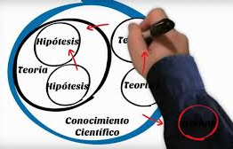
CONCLUSIONS
The conclusions of these methodologies refer to both teachers and students.
These methodologies serve as a more means for teachers to improve their level of work with their students, participating in the tasks presented with the educational materials elaborated. At the same time it serves to discover the attitudes of the students, their willingness to work and the curiosity for research.
With these learning media students are able to work in a more practical way the contents and to acquire training and information for their later use in STEMC subjects.

Slide 30
BIBLIOGRAPHY
Aparici, R. (Coord.) (2010). Conectados en el ciberespacio. Madrid: UNED.
Aparici, R. y Silva, M. (2012). Pedagogy of interactivity. Communicate, Nº38, v. XIX,
Carlos Sola Ayape. 2005. Problem-Based Learning: From Theory to Practice. México: Trillas.
Carrasco, C. J. G., & Pérez, R. A. R. (2014). Learn to teach social sciences with methods of inquiry. Case studies in teacher training. REDU. Journal of University Teaching.
Colomina,R., y Onrubia,J. (2001) "Educational interaction and school learning: Student interaction" Chap. 16 Psychological development and education. Vol. 2 (2ª ed.) Madrid: Alianza Editorial
Hernández, F. (2000). Work projects. Educar, (26)
Lobato, C. (1998) Group work. Co-op learning in high school. Bilbao: Euska Erico Unibersitatea.
Silva, M. (2005). Interactive Education: teaching and learning in person and online. Barcelona: Gedisa.

